Slide 1
Cybersecurity & Hacking

Slide 2
The project

Slide 3
During this term, you are going to learn what is cybersecurity and hacking a system.
Follow the steps in this presentation

Slide 4
Steps for this project:
I - Introduction
What is cybersecurity
Study of a very famous hack
Learning cybersecurity and hacking
II - Your Project
Present the results of your study

Slide 5
Introduction

Slide 6
What are cybersecurity and hacking
Study of a very serious hack
Learning cybersecurity and hacking

Slide 7

https://www.youtube.com/watch?v=AuYNXgO_f3Y
What are cybersecurity and hacking

Slide 8

What are cybersecurity and hacking

Slide 9
Study a very famous hack
In pairs, look online for a famous hack you are curious about:
Research information about this hack (story, hackers, reasons…).
Create a presentation where you present this hack and answer those questions:
Who did it? To whom? To get what: information, money, something else?
Where and when did this happen?
What is a crime? What happened to the hackers?
What did they do with that information / money…?
What are the solution the victim put in place after this event?

Slide 10
What are tools they used? Can we still do that nowadays?
What major changes this hack did to our society?
What do you think about this event? Would you have done the same? If yes, why? If no, why?
Is there any hack or hacks that happened after that event?
Can you explain what is a white hat and a black hat? Can you find examples of those kind of hacks?
Conclusion: can hacking be useful?

Slide 11
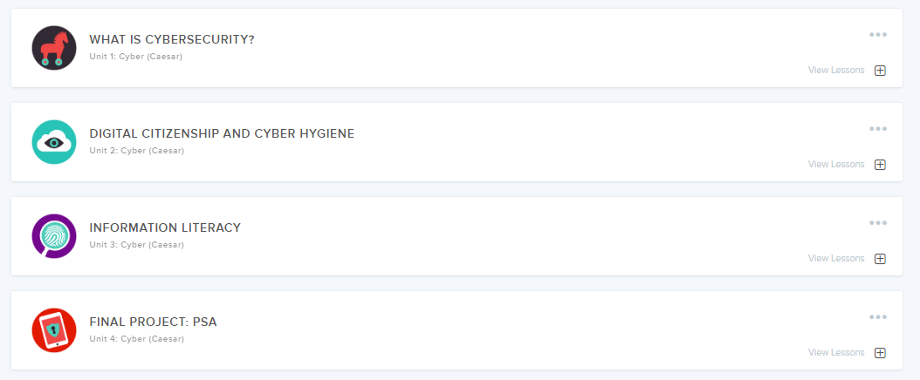
Learning cybersecurity and hacking
Go to codeHS: this is the whole unit for cybersecurity and hacking - Follow the steps

Slide 12
Your turn now

Slide 13
Now you will present the results of your studies to the rest of the class,
Prepare a presentation and get ready for a 5-10 min presentation about:
a famous hacker
a famous hack
different ways to protect your data

